Slide 1
CENTAURION LABS
Automate Your Edge

Slide 2
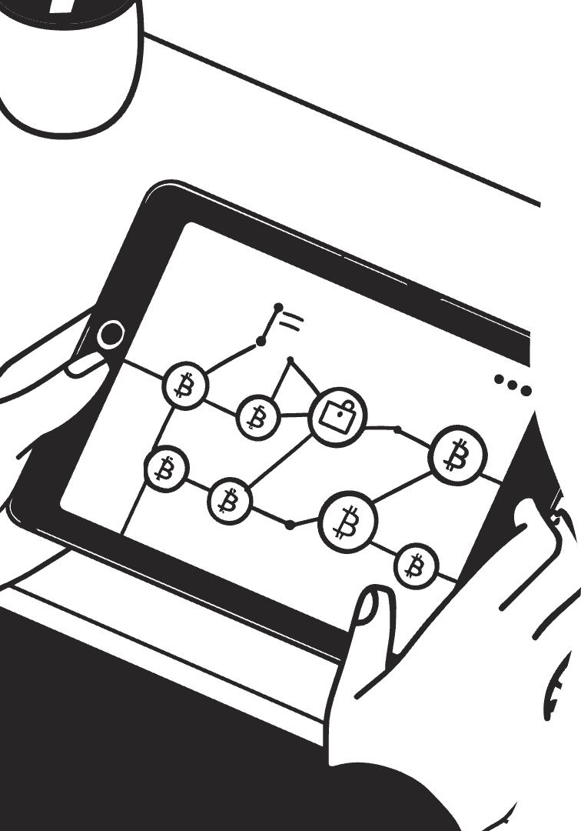
Transforming Trading Strategies into Precision Automation
Turn your trading strategy into a precision engine. We provide the tools and expertise to automate your edge. Benefit from institutional-grade foundations designed for reliability and speed. Automate without compromising on your strategy.

Slide 3
Institutional-Grade Foundations
Industry Expertise
Seamless Integration
Designed by professionals with experience at market leaders. We adhere to rigorous technical standards. No "hobbyist code" here.
Focus on reliability, speed, and seamless integration. Experience dependable performance. Lightning fast responsiveness on feedback loops.

Slide 4
Your Strategy, Your Rules
Strategy Review
Custom Development
Testing & Delivery
We don't sell pre-built systems or black-box algorithms. Your logic drives every trade. Experience a clear process with weekly updates. Your feedback is integrated throughout the development lifecycle.

Slide 5
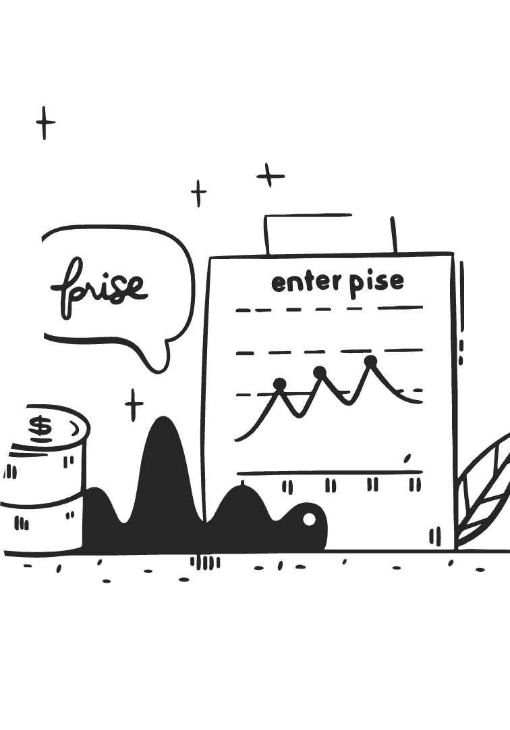
Zero-Risk Start
1
Free Strategy Audit
We analyze your idea's viability before commitment. Understand your strategy's potential.
2
Beta Testing Phase
We fix bugs for free until you're confident. Launch with complete confidence.

Slide 6
Flexible Pricing
Fixed Fee
Pay-as-You-Profit
Transparent upfront quote.
Small % of your sales profits.
Choose the pricing that works for you. Fixed fee provides cost certainty. Pay-as-you-profit aligns our incentives with your success.

Slide 7
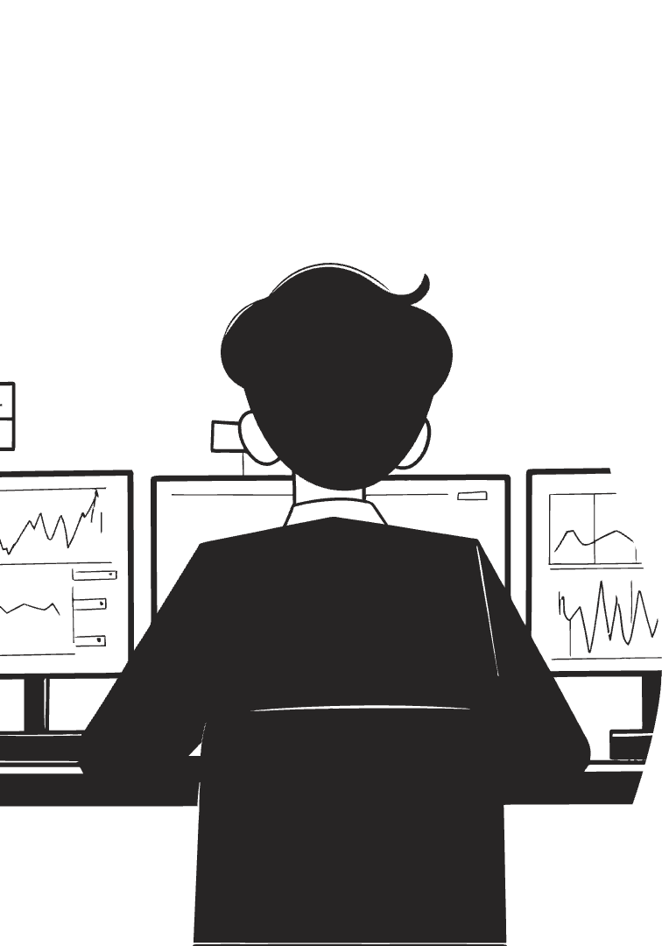
Ideal for Traders Who...
Have a clear strategy but lack technical skills.
Want to automate discipline, removing emotional trading.
Value transparency over empty promises.

Slide 8
What We Don’t Do
Reuse your strategy – your IP stays yours.
Lock you into subscriptions for basic fixes.
Sell “guaranteed profit” scams.
We prioritize integrity and client control. Your strategy is safe with us.

Slide 9
Launch Offer
10%
Discount
10% Discount on your first EA.
Free
Audit
Free Strategy Audit
Founding Clients receive a free strategy audit. Benefit from priority access to future tools.

